Slide 1
Debt Sustainability and Growth in the Caribbean by A. Presbitero, L. Andrian, J. Kozlowski, V. Mercer-Blackman, A. Rebucci and D. Seerattan
Presented at the 5th Biennial International Conference on Business, Banking and Finance
Learning Resource Centre
University of the West Indies
St. Augustine
2-3 May 2013

Slide 2
OVERVIEW OF PRESENTATION
Introduction and rationale
Methodology
Simulation results
Measuring the efficiency of public expenditure
Conclusion

Slide 3
Introduction
High debt and low growth dynamics in many Caribbean countries
Debt dynamics suggest that a significant fiscal adjustment is required to foster sustainability
Evidence suggests that consolidation in depressed conditions suppresses growth especially in DMEs but there is some studies which suggest that consolidation can foster growth in EMEs because of low fiscal multipliers and in situations where the debt sustainability issues is the major driver of low business and consumer confidence
The issue of the mix of policies to be used in the consolidation programme is also a central issues with some studies suggesting that expenditure reduction is more effective than tax increases in certain circumstances, particularly conditions where the effectiveness of government expenditure programmes is questionable

Slide 4
Methodology
The paper revisits the traditional (partial) approach to debt sustainability
The problem is that the TA provides information on the size of the adjustment but no guidance on policy options
To address this weakness we modify the TA by adding a behavioural model of the economy to the government dynamic budget constraint (Andrian, Kozlowski and Rebucci, 2012)
We employ two alternative growth models, a neoclassical growth model with unproductive expenditures and an endogenous growth model with productive expenditures
Within these two models (which depict two scenarios) we can accommodate overlapping generations and different degrees of inter-temporal elasticity of substitution

Slide 5
Methodology
In the neoclassical model public expenditure does not affect consumption and output since in this model the steady state growth is exogenous and constant by definition but since the real interest rate is endogenously determined taxation will therefore affect the level of these variables
In this model a reduction in expenditure leads to a temp. surge in consumption while raising taxes lowers the equilibrium level of output and capital
In the endogenous growth model with productive expenditure public spending is included in the production function so fiscal policy affects the interest rate
The basic result is that the size of the fiscal adjustment depends on the fiscal policy mix. Also, the required fiscal adjustment is increases with the inverse of the inter-temporal elasticity of substitution

Slide 6
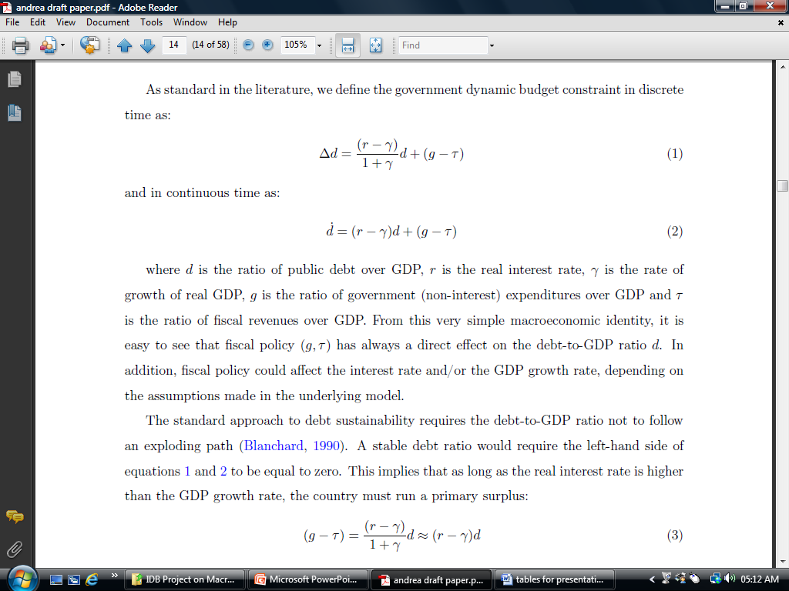
Methodology - Government Dynamic Budget Constraint

Slide 7
Methodology - Cobb-Douglas Production Function

Slide 8
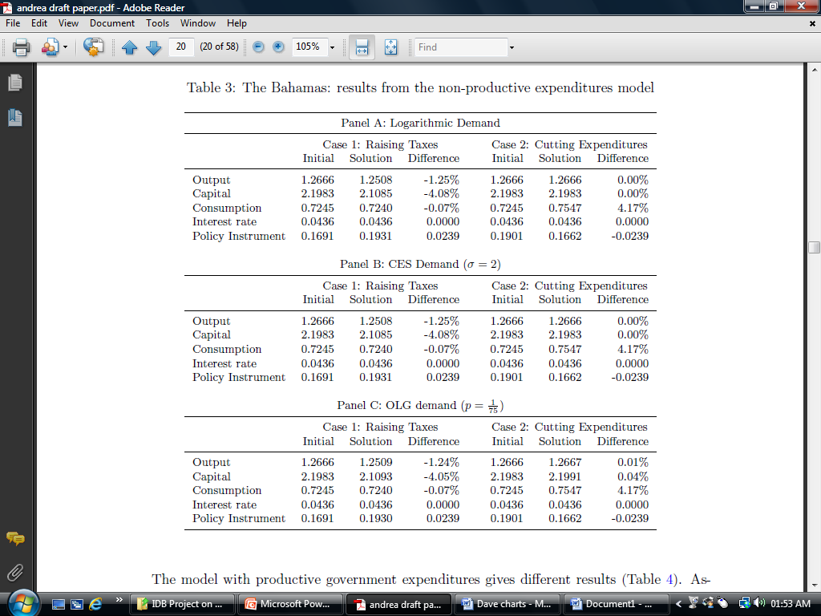

Slide 9
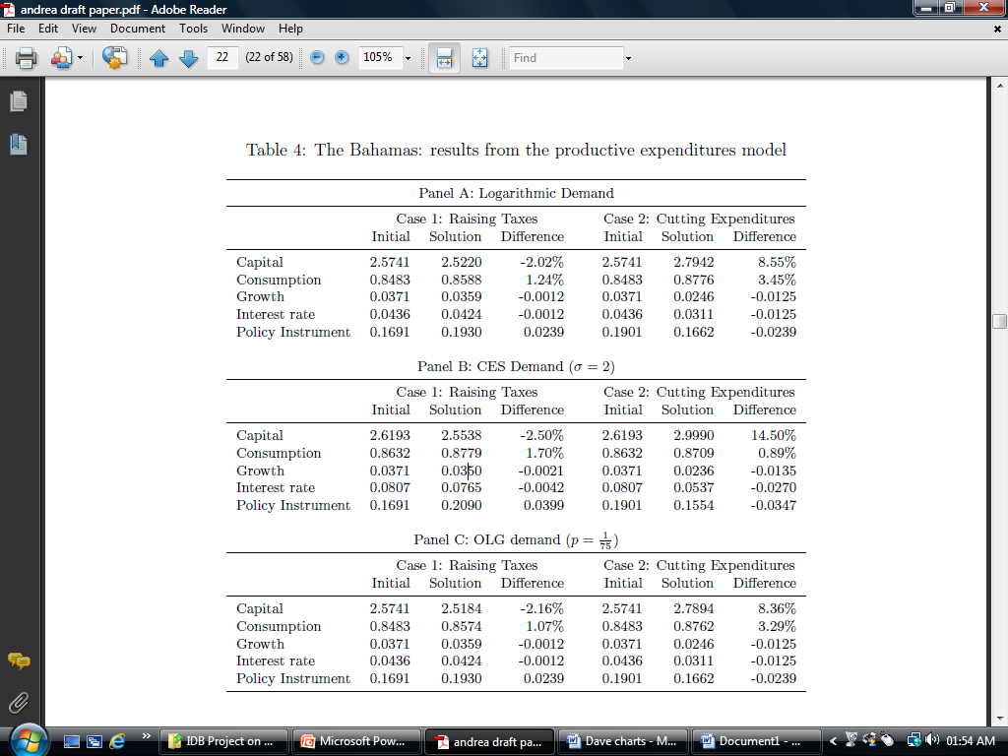

Slide 10
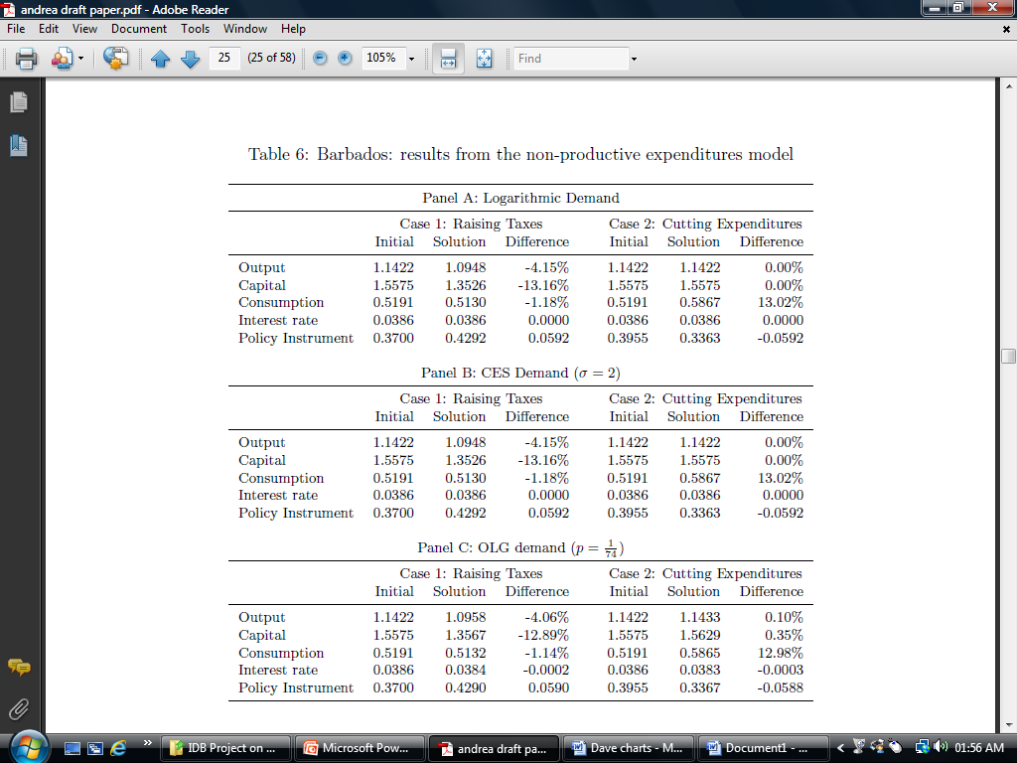

Slide 11
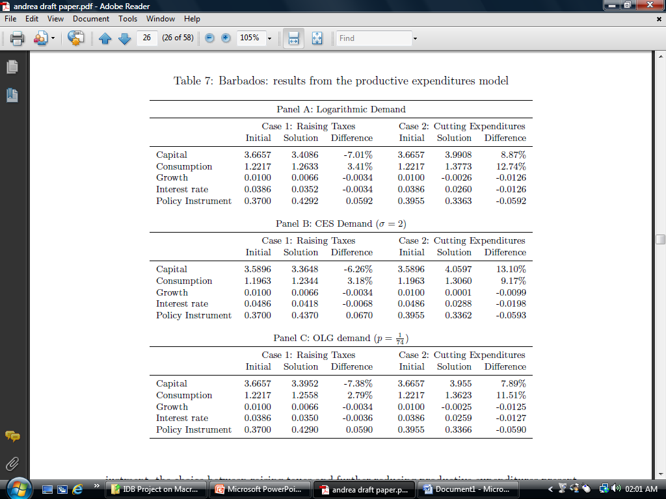

Slide 12
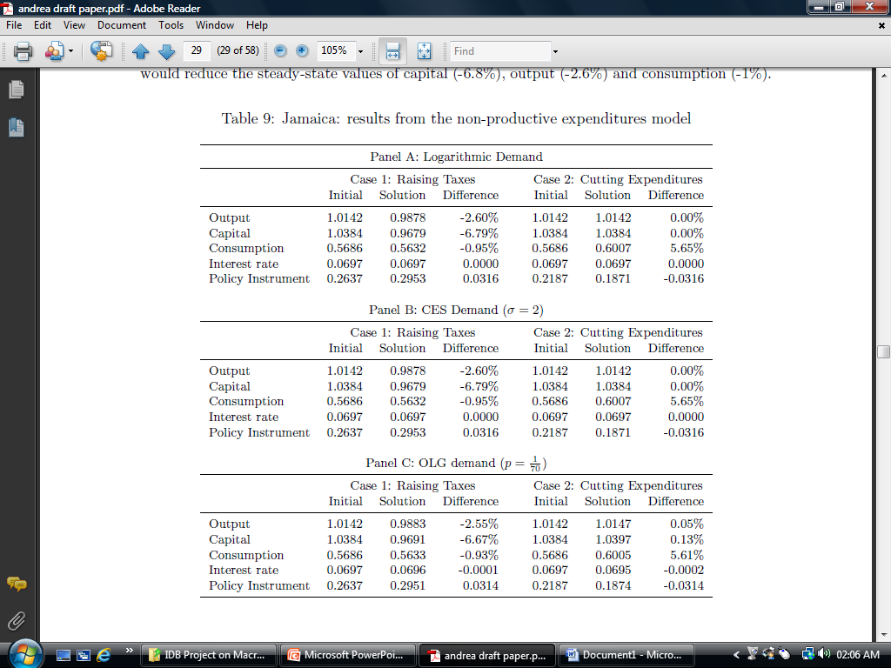

Slide 13
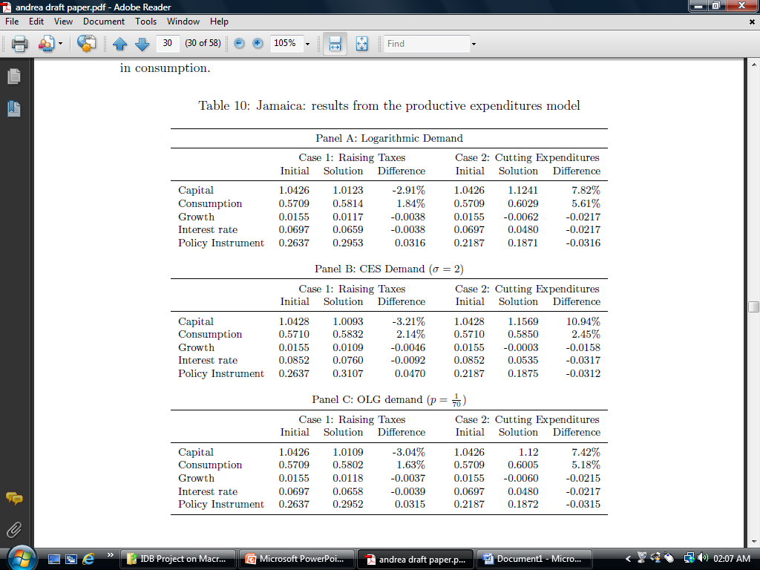

Slide 14
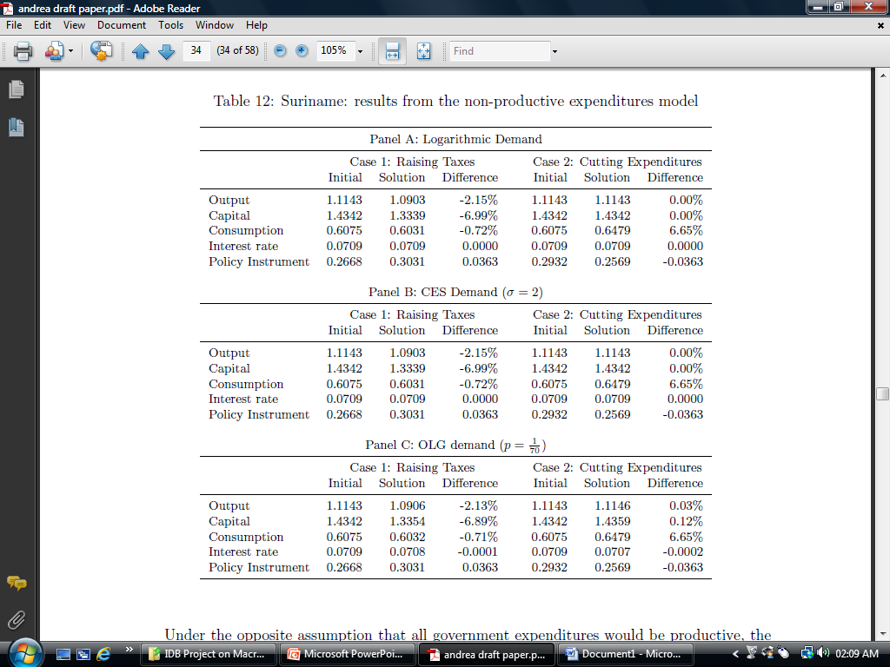

Slide 16
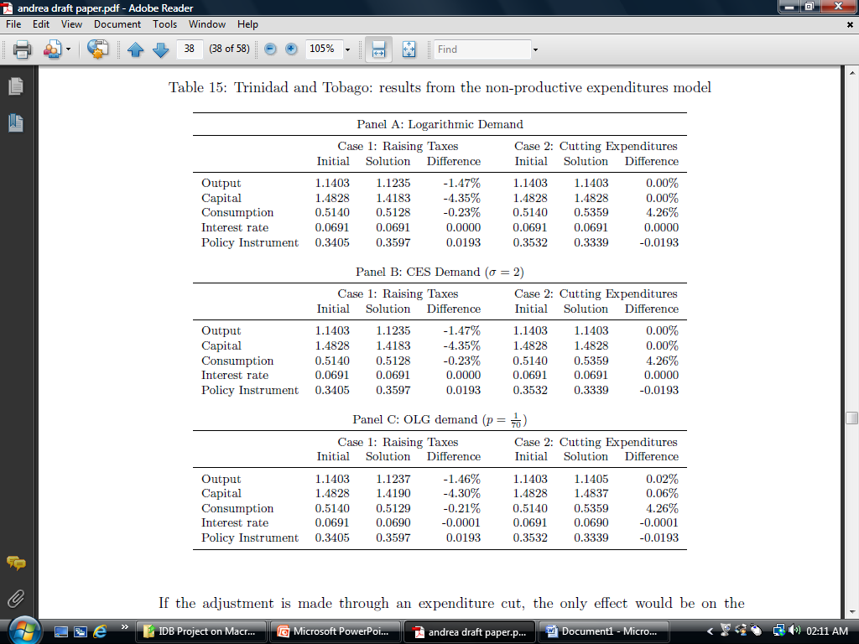

Slide 18
Measuring the Efficiency of Government Expenditure
Non-parametric efficiency frontier approach because of the simplicity and to avoid the complexity of defining the functional form of the efficiency frontier if we use the parametric approach
Free Disposable Hull Analysis (FDH)
The approach adopted by Alphonso et. al. (2005) based on the development of composite indicators of public sector performance, weighting these indicators by normalised GE to get an idea of efficiency and then using this information to develop the efficiency frontier and then benchmarking countries’ performance on this frontier

Slide 19
Expenditure Performance Indicators
Country | Indicators
 |  | Adminis- tration | Health | Education | Infra- structure | Distri- bution | Economic Stability | Economic Performance | Total
Bahamas | PSEP | 0.9767 | 0.7300 | 1.0500 | 0.6900 | 0.9200 | 0.3550 | 0.6533 | 0.7679
 | GE | 13.2000 | 3.4000 | 3.5000 | 2.9000 | 2.9000 | 21.0000 | 21.0000
 | Norm GE | 1.0326 | 1.0303 | 0.8468 | 0.7436 | 0.3867 | 0.7275 | 0.7275
 | PSEE | 0.9458 | 0.7085 | 1.2400 | 0.9279 | 2.3793 | 0.4880 | 0.8981 | 1.0840
Barbados | PSEP | 1.0976 | 0.6736 | 1.1031 | 0.7466 | 1.0870 | 0.2838 | 0.4907 | 0.7832
 | GE | 15.2000 | 2.9000 | 6.7000 | 4.7000 | 11.2000 | 35.9000 | 35.9000
 | Norm GE | 1.1890 | 0.8788 | 1.6210 | 1.2051 | 1.4933 | 1.2436 | 1.2436
 | PSEE | 0.9231 | 0.7665 | 0.6805 | 0.6195 | 0.7279 | 0.2282 | 0.3946 | 0.6200
Jamaica | PSEP | 0.0282 | 0.6710 | 0.9073 | 0.6232 | 0.6536 | 0.2057 | 1.0213 | 0.5872
 | GE | 10.7000 | 2.6000 | 4.8000 | 2.4000 | 5.9000 | 33.1000 | 33.1000
 | Norm GE | 0.8370 | 0.7879 | 1.1613 | 0.6154 | 0.7867 | 1.1467 | 1.1467
 | PSEE | 0.0337 | 0.8516 | 0.7812 | 1.0128 | 0.8308 | 0.1794 | 0.8907 | 0.6543
Suriname | PSEP | 0.4017 | 0.5418 | 0.9410 | 0.5729 | 0.6667 | 0.1588 | 1.6078 | 0.5839
 | GE | 18.9000 | 2.5000 | 3.5000 | 4.1000 | 5.2000 | 30.2000 | 30.2000
 | Norm GE | 1.4785 | 0.7576 | 0.8468 | 1.0513 | 0.6933 | 1.0462 | 1.0462
 | PSEE | 0.2717 | 0.7152 | 1.1113 | 0.5449 | 0.9615 | 0.1518 | 1.5369 | 0.6785
Trinidad and Tobago | PSEP | 0.1281 | 0.5504 | 0.9733 | 0.6335 | 0.6024 | 0.2593 | 2.9839 | 0.8758
 | GE | 9.2000 | 2.4000 | 4.2000 | 3.6000 | 11.2000 | 27.1000 | 27.1000
 | Norm GE | 0.7197 | 0.7273 | 1.0161 | 0.9231 | 1.4933 | 0.9388 | 0.9388
 | PSEE | 0.1780 | 0.7568 | 0.9578 | 0.6863 | 0.4034 | 0.2762 | 3.1784 | 0.9196
Car. Ave. | PSEP | 0.3658 | 0.6333 | 0.9949 | 0.6532 | 0.7859 | 0.2525 | 1.3514 | 0.7196
Car. Ave. | PSEE | 0.3618 | 0.7597 | 0.9542 | 0.7583 | 1.0606 | 0.2647 | 1.3797 | 0.8339

Slide 20
Input Efficiency Scores
Country | Expenditure Component
 | Health | Education | Wages and Salaries | Capital Expenditure | Subsidies and Transfers | Total Expenditure
The Bahamas | 1.0000 | 1.0000 | 1.0000 | 0.8276 | 1.0000 | 1.0000
Suriname | 0.9600 | 1.0000 | 0.4868 | 0.5854 | 0.5577 | 0.6954
Jamaica | 0.9231 | 0.7292 | 0.8598 | 1.0000 | 0.4915 | 0.6344
Malaysia | 0.5667 | 1.0000 | 0.9684 | 0.8246 | 1.0000 | 1.0000
Barbados | 0.8276 | 0.5224 | 0.8684 | 1.0000 | 0.7679 | 0.7214
Trinidad | 1.0000 | 0.8333 | 1.0000 | 0.6667 | 0.2589 | 0.9557
Caribbean Average | 0.9421 | 0.8169 | 0.8430 | 0.8159 | 0.6152 | 0.8013

Slide 21
SUMMARY
Some countries require significant adjustment to restore sustainability
Fiscal consolidation may help growth in the Caribbean in countries with a severe debt problem, where confidence is badly damaged and in the context of the highly open nature of Caribbean economies and the related low fiscal multipliers
The optimal policy mix dependent on the functioning of the economy and in particular on the calibration of the elasticity of substitution – low values of the ES implies that consumption is not sensitive to interest rate which is more appropriate for the Caribbean
Also depends on the degree to which expenditure is productive or not
Best approach is to cut expenditure in cases where its unproductive but use tax increases in cases where it is productive given the distribution of costs and benefits
Estimates of expenditure efficiency implies that there are opportunities for cutting unproductive expenditure which would not dampen growth above and beyond that caused by factors other than fiscal policy

Slide 22
THANK YOU FOR YOUR ATTENTION
The University of the West Indies
St. Augustine, Trinidad and Tobago
Phone: (868) 662-2002 ext. 82552, Fax: (868) 645-6017
E-Mail: Dave.Seerattan@sta.uwi.edu
Website: www.ccmfuwi.org

